Slide 1
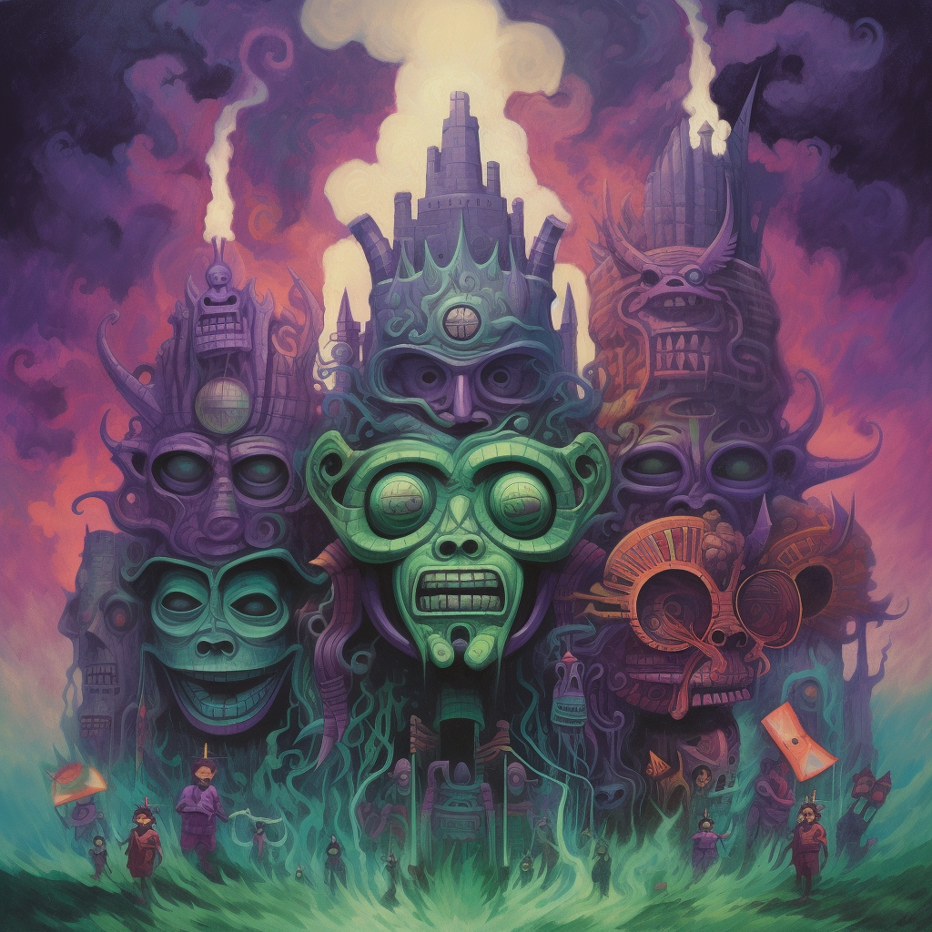
INCURSION
CHARACTER UI BRIEF

Slide 2
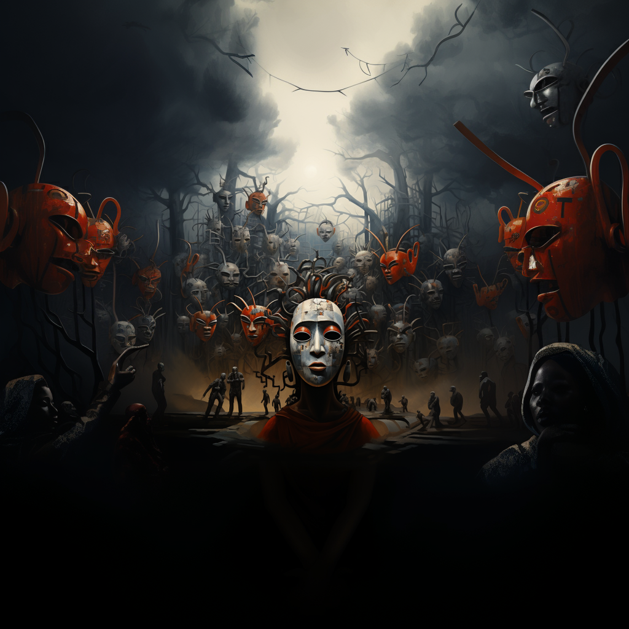
INCURSION
PREMISE
It’s a psychological horror where a ‘modern ‘ witchdoctor is attempting to find the source of a series of possesions .
The protagonist enters the mind of the ‘patient’ entering a symbolic dreamscape where she uses her own emotions to destroy the pieces of the creature that is causing the possession, while searching for clues to its origin body

Slide 3
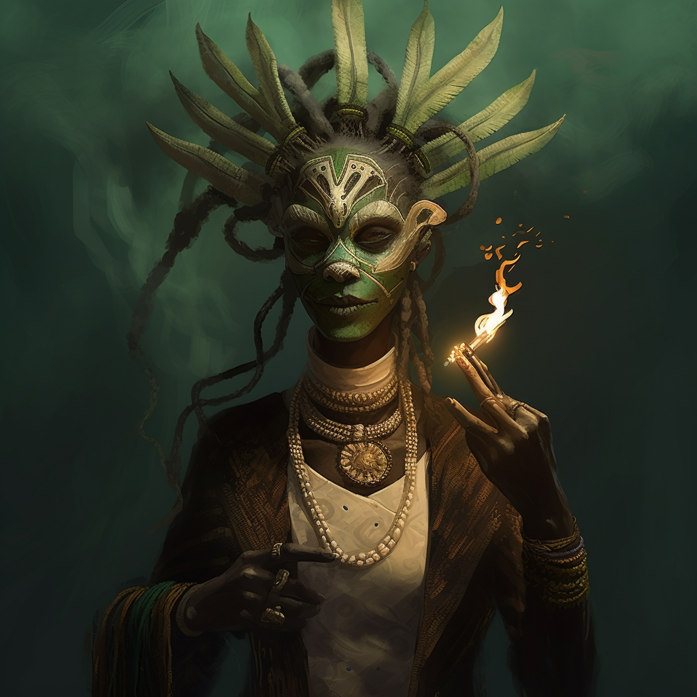






THE EMOTIONS
There are six emotions that for the core of the protagonists abilities:
The emotions are in three opposing pairs – each member of a pair a counter to the other
RAGE
SERENITY
RESOLVE
FEAR
DESIRE
DISGUST
The emotions will always be represented by the corresponding colour and the mask ( above are placeholders)

Slide 4
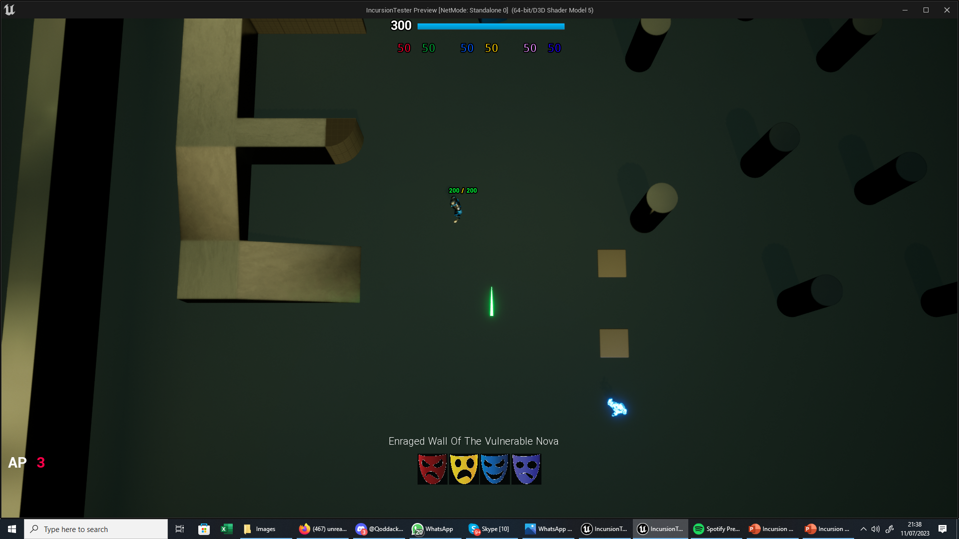
DEMO LEVEL

Slide 5

300
50
50
50
50
50
50
THE IN GAME UI
These are the 4 ELEMENTS of the main ui
FOCUSED BEAM OF THE RAGING INFERNO
5.0
CAST
SHEILD
INTERACT

Slide 6
THE SANITY BAR
Total Sanity – Think of it as health. It is the sum total of the values of the six emotions . It has both a number and a bar
300
50
50
50
50
50
50
Emotion Pair - The pair is always joined together. As ones value goes up the other decreases and vice versa. The max value is 100 but the opposing emotion would be reduced to zero
They are represented by the mask and the colour

Slide 7
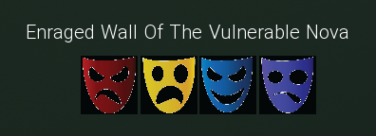
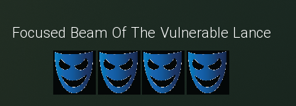
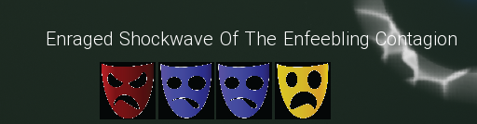
THE ABILITY CREATOR
By pressing - q,w,e,r,t,y the user can create a custom ability determined by the combination and order of emorions chosen
FOCUSED BEAM OF THE RAGING INFERNO
DAMAGE
SHAPE
SPECIAL EFFECT
IMPACT EFFECT

Slide 8
THE TIME BAR
ACTIONS
5.0
CAST
SHEILD
INTERACT
It’s a turn based game. During the players turn this bar tells them how many actions they have left
Each action has a time cost and is deducted from the total of 5 once planned out
The key actions a player can take during their turn
They are grayed out during the enemies turn

Slide 9
THE BRIEF
Menu Screen art – You can use the ref I shared
Main Font – Something spooky but feels tribal / African
New design for the masks that represent the emotions (png)
Rework the UI elements .
Keep the structure of the Sanity Bar as the relationship between the total and the emotion pairs needs to be maintained.
The cast bar needs to maintain the link to the description and the component
A cool texture / feel for the loading bar. - The bar is masked and the mask increases / decreases as the value changes

